Slide 1
Stores Sales Prediction

Slide 2
Objective:
Development of a predictive model for Item Outlet Sales . The model will predict the sales of the specified items in stores and Big Marts
Benefits:
Estimates of Future Sales.
Provides Production Planning.
Helps in Purchasing the items.
Helps in Sales Strategy .

Slide 3
Data Sharing Agreement :
Sample file name (Train.csv)
Number of Columns
Column names
Column data type

Slide 4
Data Schema
Feature name | Datatype | Null/Required
Item Weight | float | Required
Item Fat Content | object | Required
Item Visibility | float | Required
Item Type | object | Required
Item MRP | float | Required
Outlet Identifier | object | Required
Outlet Establishment Year | int | Required
Outlet Size | object | Required
Outlet Location Type | object | Required
Outlet Type | object | Required
Item Outlet Sales | float | Required

Slide 5
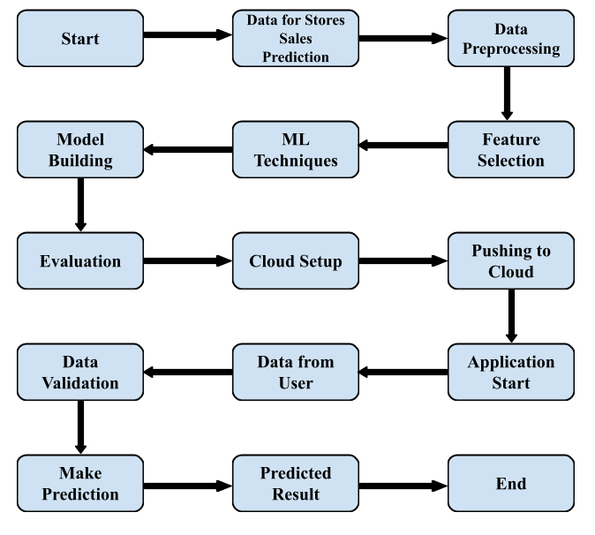
Architecture

Slide 6
Architecture Description
Data Description
The dataset used in this project is collected from Kaggle. The dataset is divided into two sets of data. One is the test (5681) data and the other is the train (8523) data. The train dataset has both input and output variables.
Data Insertion into Database
Database Creation and connection - Create a database with name passed. If the database is already created, open the connection to the database.
Table creation in the database.
Insertion of files in the table
Data Pre-processing
Data Pre-processing steps we could use are data cleaning, data integration, data reduction and data transformation.
Feature Selection
Feature Selection helps us to find the best set of features that allows us to build the necessary model for the project. This helps in selecting a subset of features from an initially large volume of features.

Slide 7
Machine Learning Techniques
Based on the problem statement and requirements we can use supervised or unsupervised technique which fits the project.
.
Model Building
Depending on the data type of the target variable we are either going to be building a classification or regression model. The main aspect of machine learning model building is to obtain actionable insights and in order to achieve that it is important to be able to select a subset of important features from the vast number.
Evaluation
The Evaluation of accuracy can be done using the test data. Mean Absolute error can be found using test data and prediction data.
Cloud Setup
Using Heroku as the cloud deployment platform, the platform is setup for deploying the virtual app.
Pushing to Cloud
Once the cloud is setup, the virtual app created will be pushed to the cloud and will finally be deployed into the cloud

Slide 8
Application Start
Once the virtual app is deployed in to the cloud we can open the web application using any web browser.
Data from user
Using a web browser we open the web application and provide the necessary information as the input for prediction.
Data Validation
Once the input is provided and we click on the submit button, the system will provide the output based on its requirements.
Result Prediction
Once the data validation is completed the prediction will be done for the type of product in Stores and Big Marts provided in the input.

